Slide 1

GANsformer
reproducibility challenge
Hudson & Zitnick
Project for Advance Topic in Machine Learning course (21/22)
https://github.com/GiorgiaAuroraAdorni/gansformer-reproducibility-challenge
Giorgia Adorni
giorgia.adorni@usi.ch
Stefano Carlo Lambertenghi
stefano.carlo.lambertenghi@usi.ch
Felix Boelter
felix.boelter@usi.ch
Notes:
Felix

Slide 2
Introduction
Generative modelling is a “hot” topic nowadays used to generate unreal images
We investigate the reliability and reproducibility of “Generative Adversarial Transformers” by Hudson and Zitnick [2]
State-of-the art results and faster learning
Recreate the paper methods and reproduce their results
Models are implemented using authors’ code and information
We reproduced the GANformer with two types of attention and a StyleGAN2 as a baseline.
Performed tests to validate the claimed results.
Discuss inconsistencies and solutions. And finally perform a Demo.
Notes:
Felix

Slide 3

Agenda
Introduction
Background
GANs
StyleGAN2
Attention
Generative Adversarial Transformers
Simplex and Duplex attention
Implementation
Datasets
Hyper-parameters and design choices
Experimental setup
Computational requirements
Results
Implementation issues
Results discussion
Conclusions

Slide 4
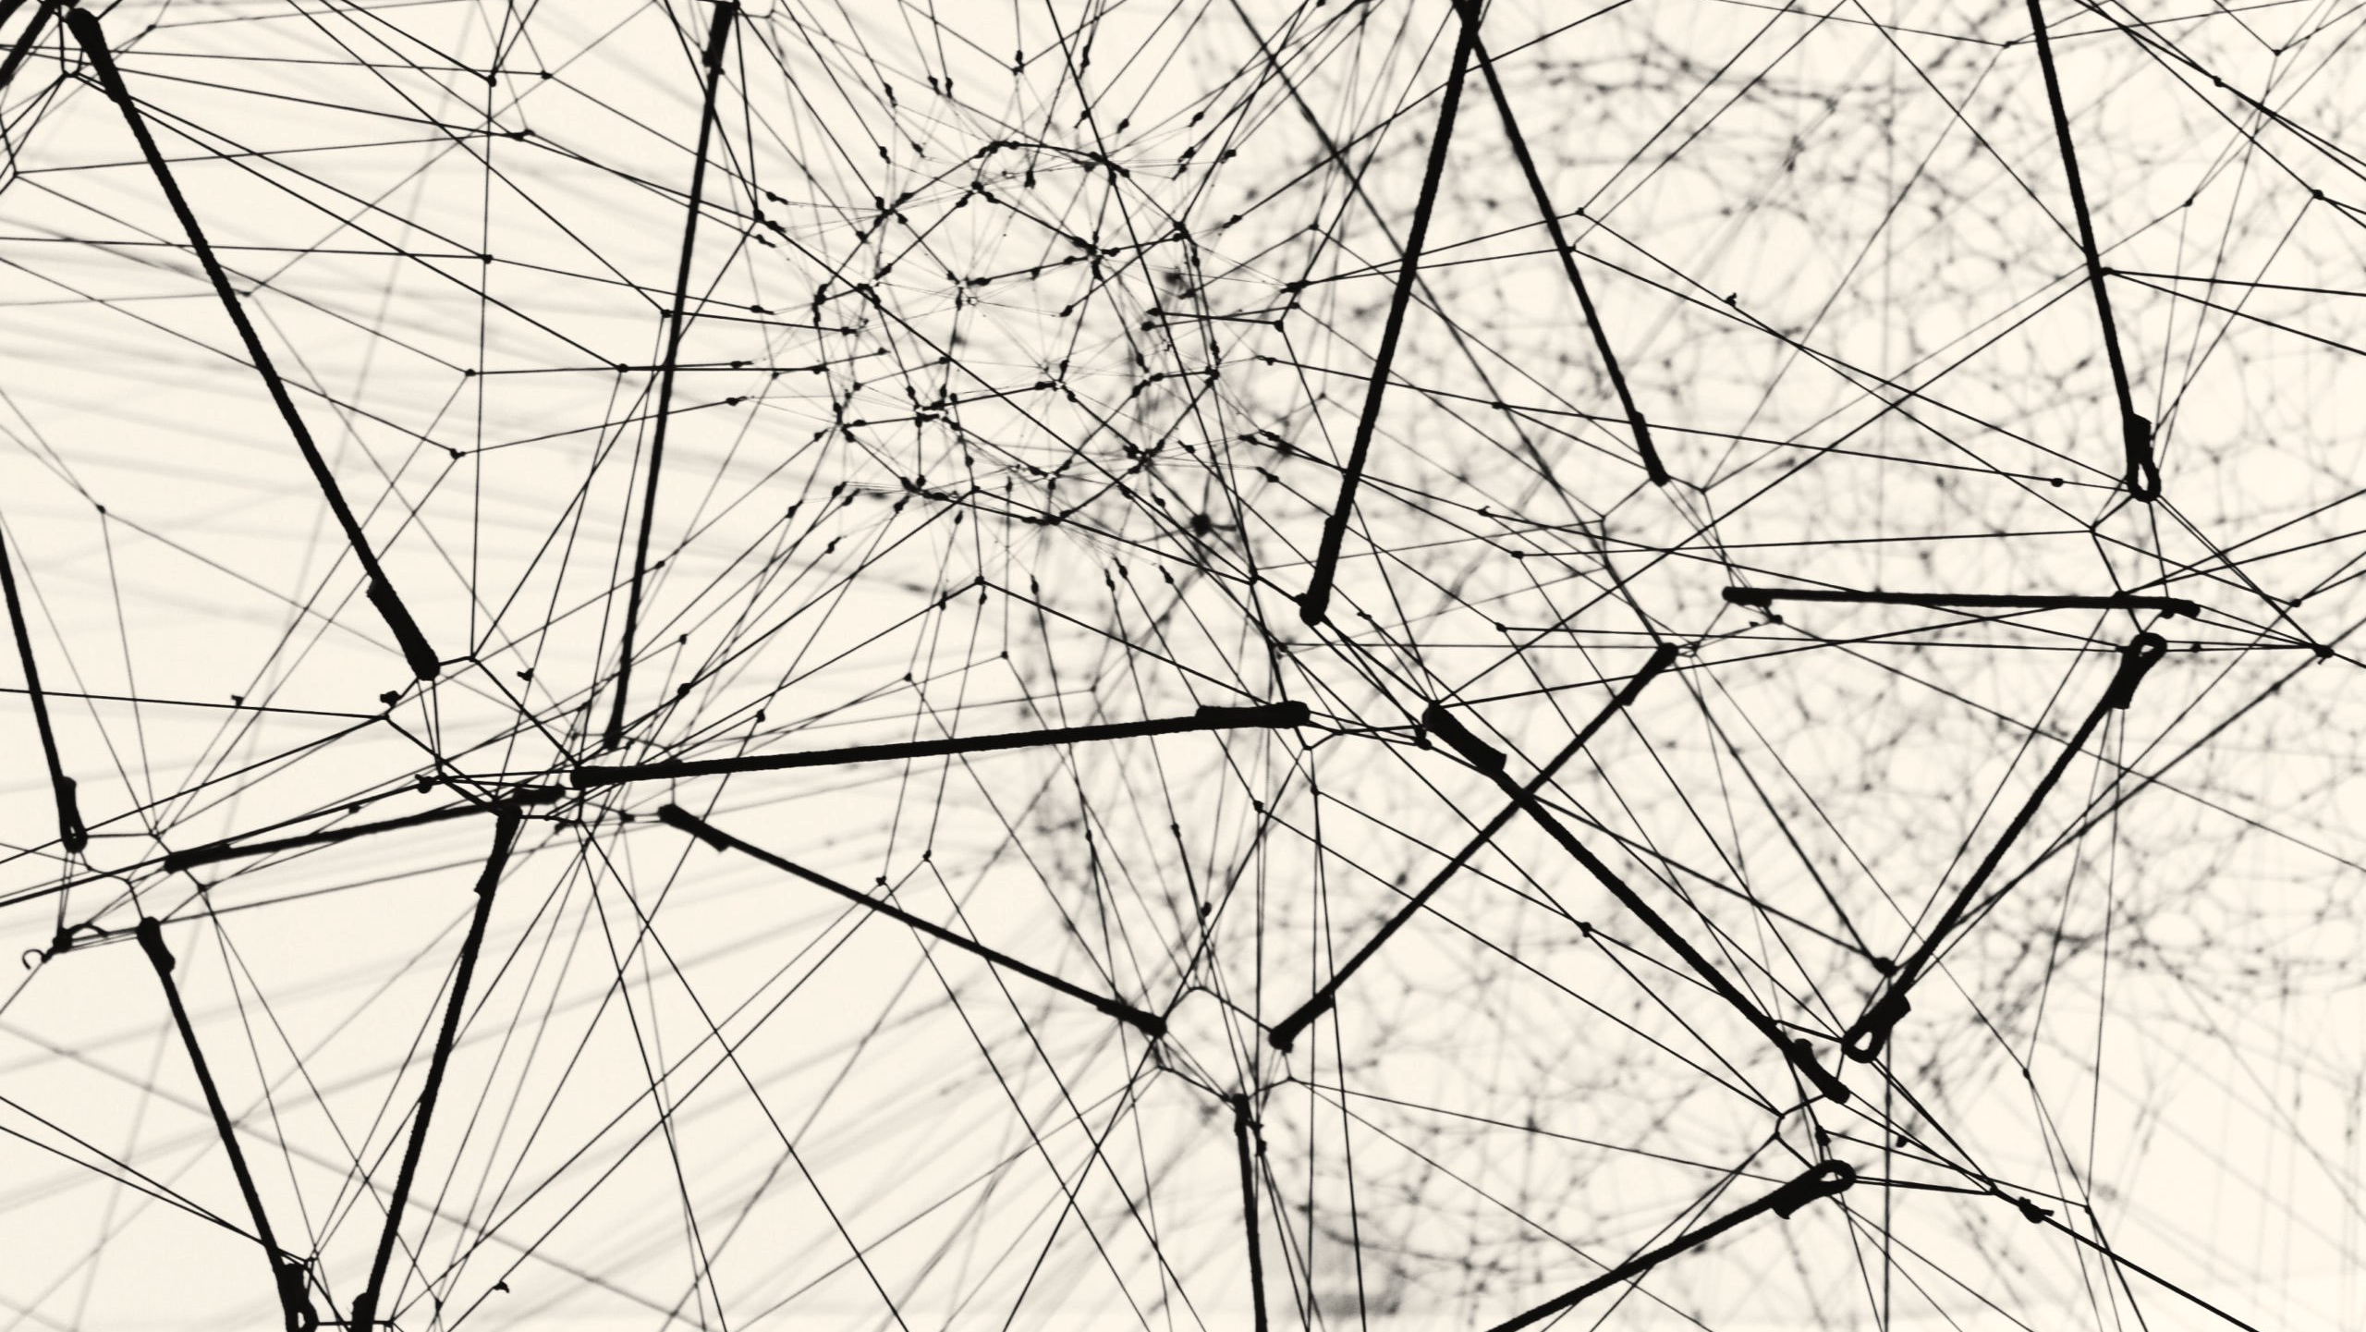
Background
Rights to Alina Grubnyak

Slide 5
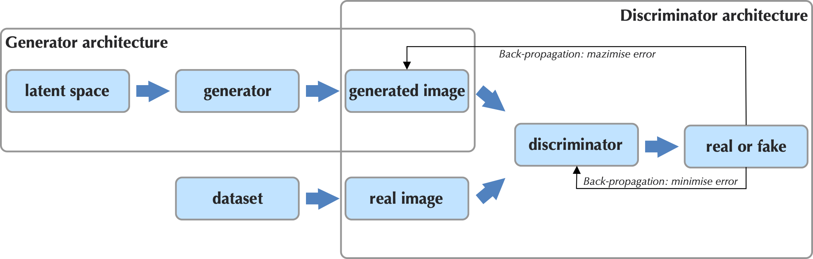
Generative Adversarial Networks (GANs) [1]
GANs: deep-learning-based generative models
the generator G(z): generates new plausible examples in the problem domain → images
the discriminator D(x): classifies the examples as real (coming from the training dataset) or fake (generated by G)
Notes:
Stefano

Slide 6
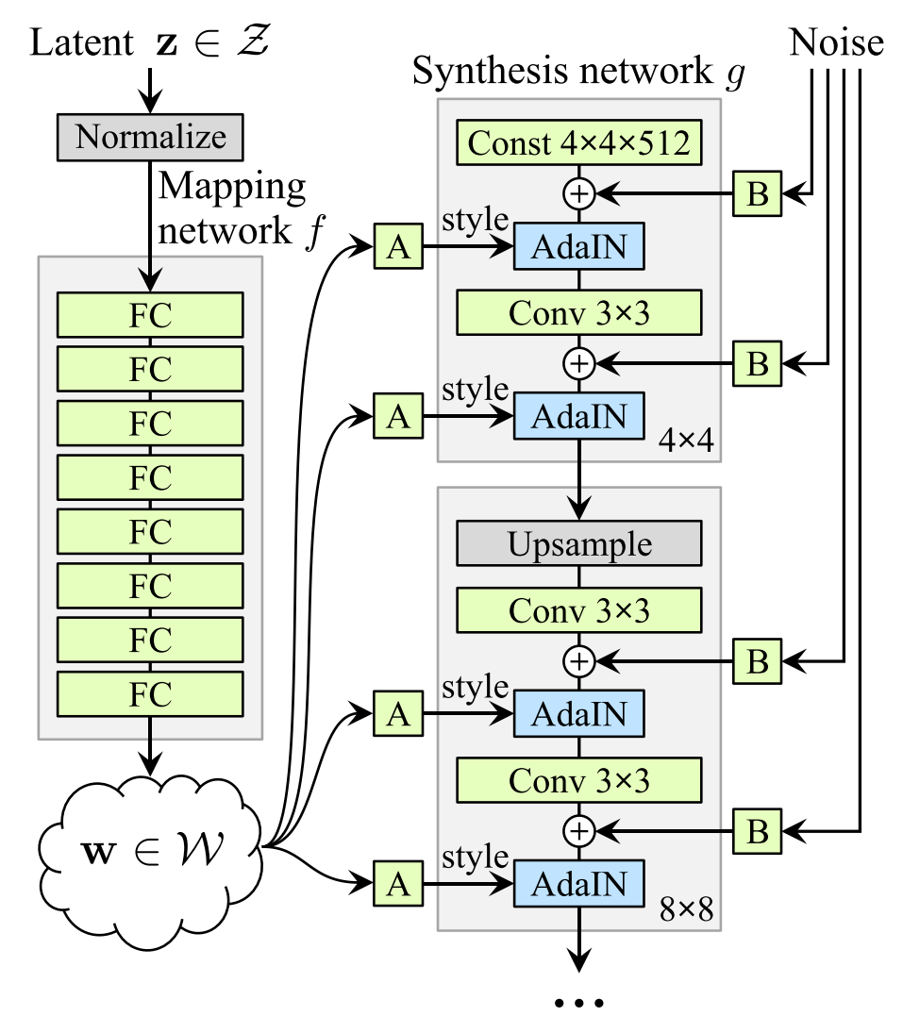
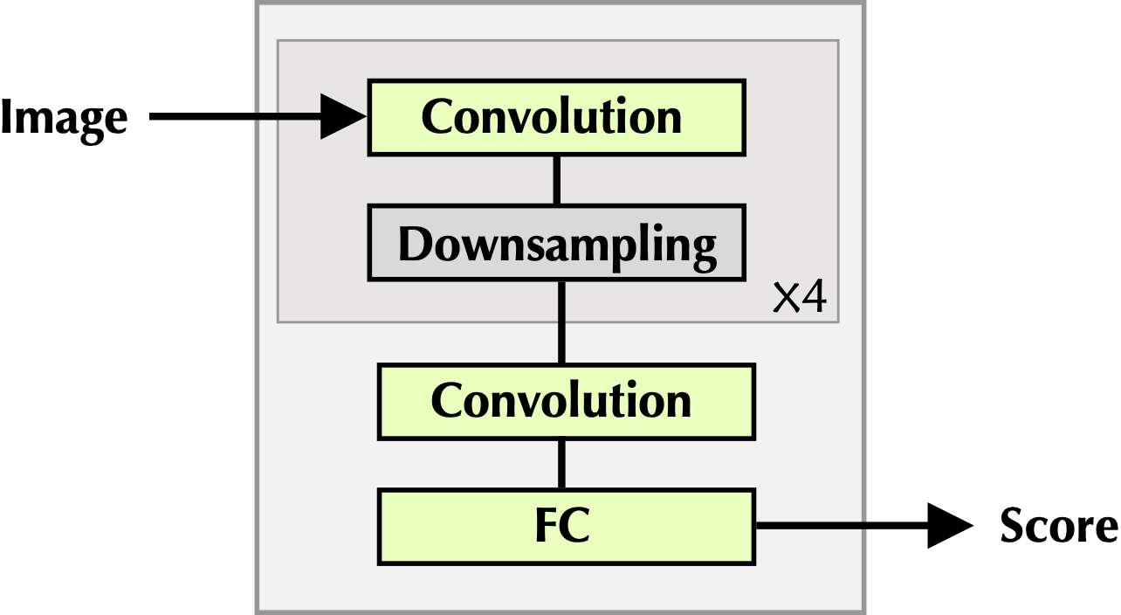
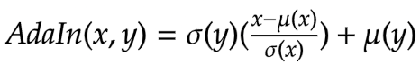
StyleGAN [4]
Generator
Discriminator
Intermediate feature map
Adaptive Instance Normalisation
Notes:
Stefano

Slide 7
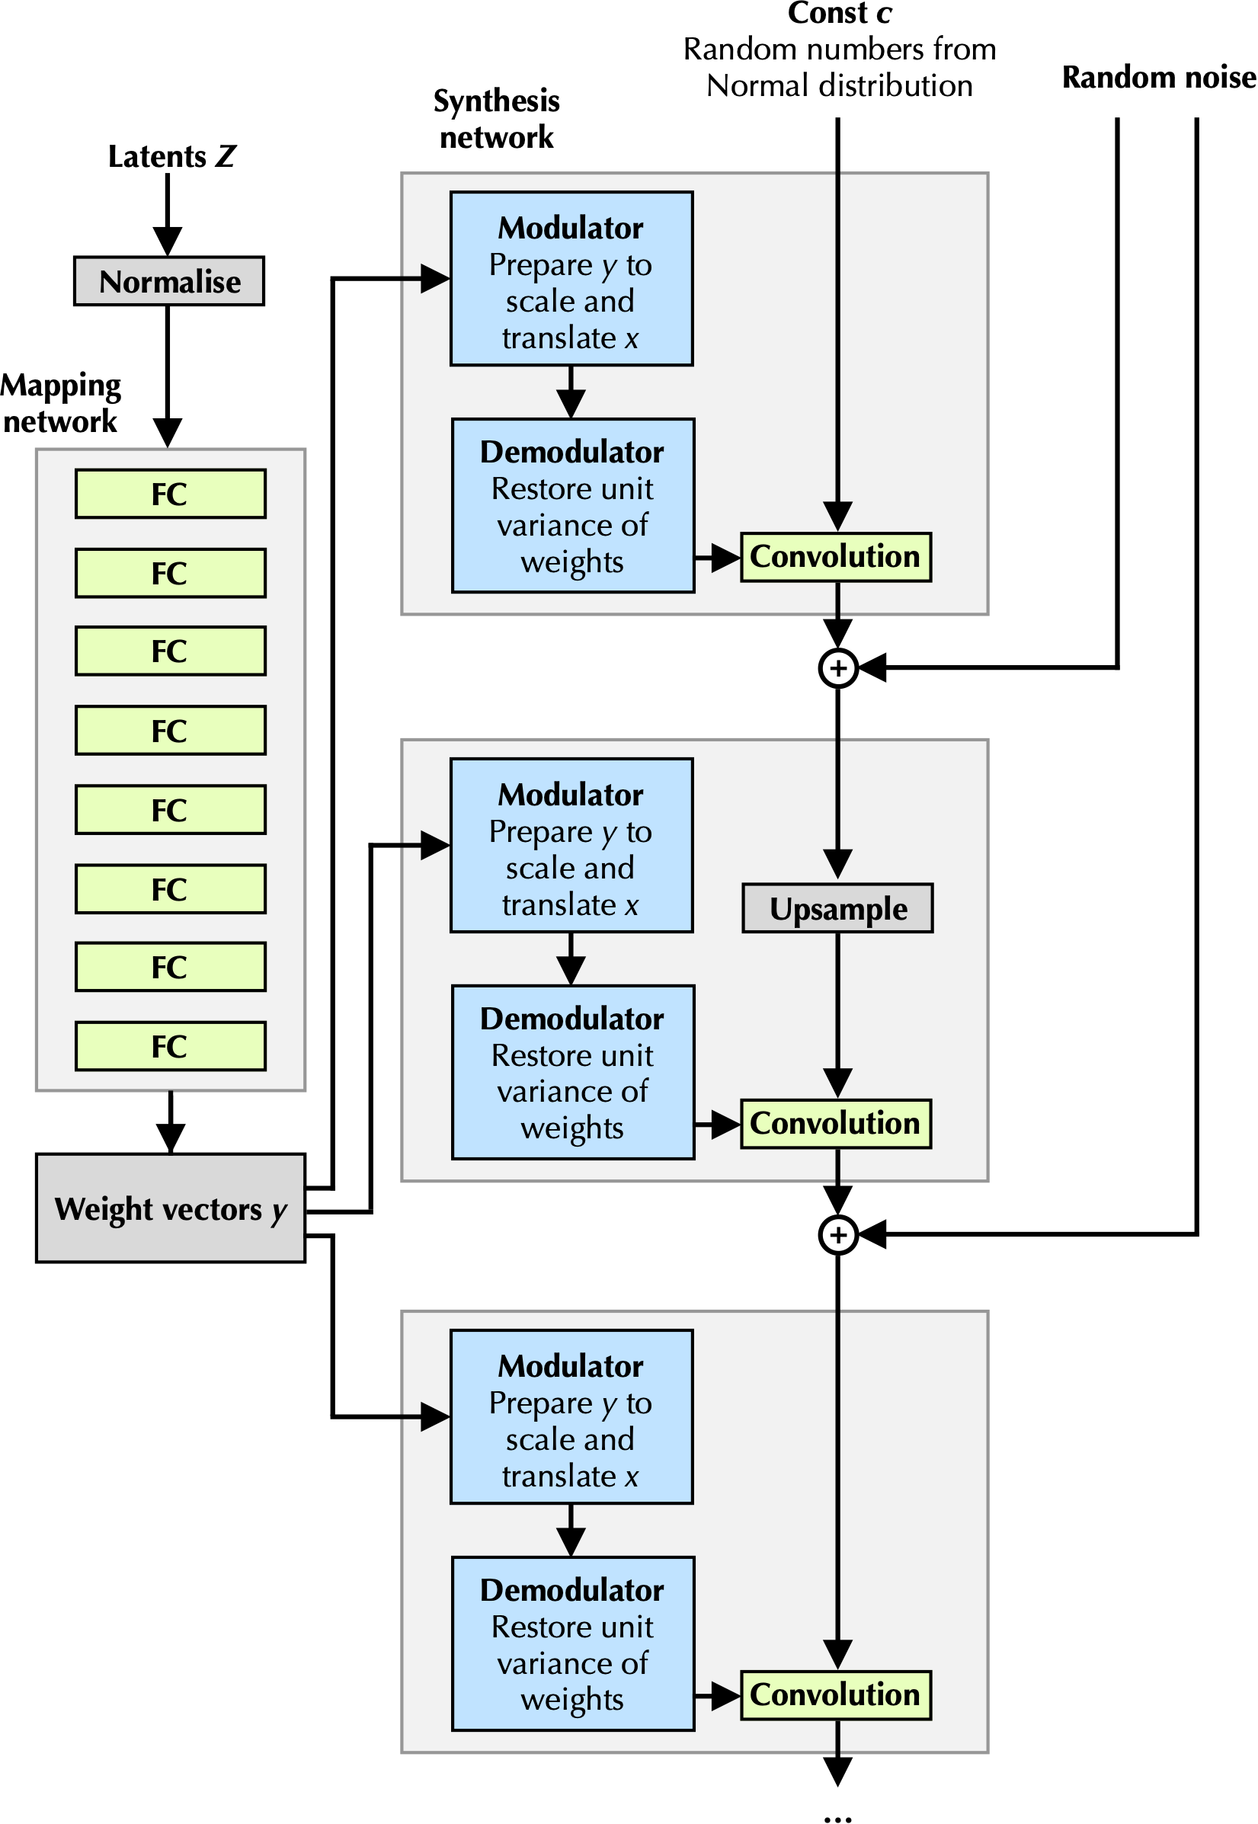
Generator
StyleGAN2 [3]
Generator
Intermediate feature map
Notes:
Stefano

Slide 8
Transformers Attention is all you need! [5, 6]
Multi-layer bidirectional transformer encoder (BERT)
The attention mechanism lets the network understand which are the image features by deciding on which parts of the image to concentrate on
Pros:
Strength for long-range interactions → understand the context of the image
More parallelisation and less training times
Cons:
High demand of computational resources
Notes:
GIORGIA

Slide 9
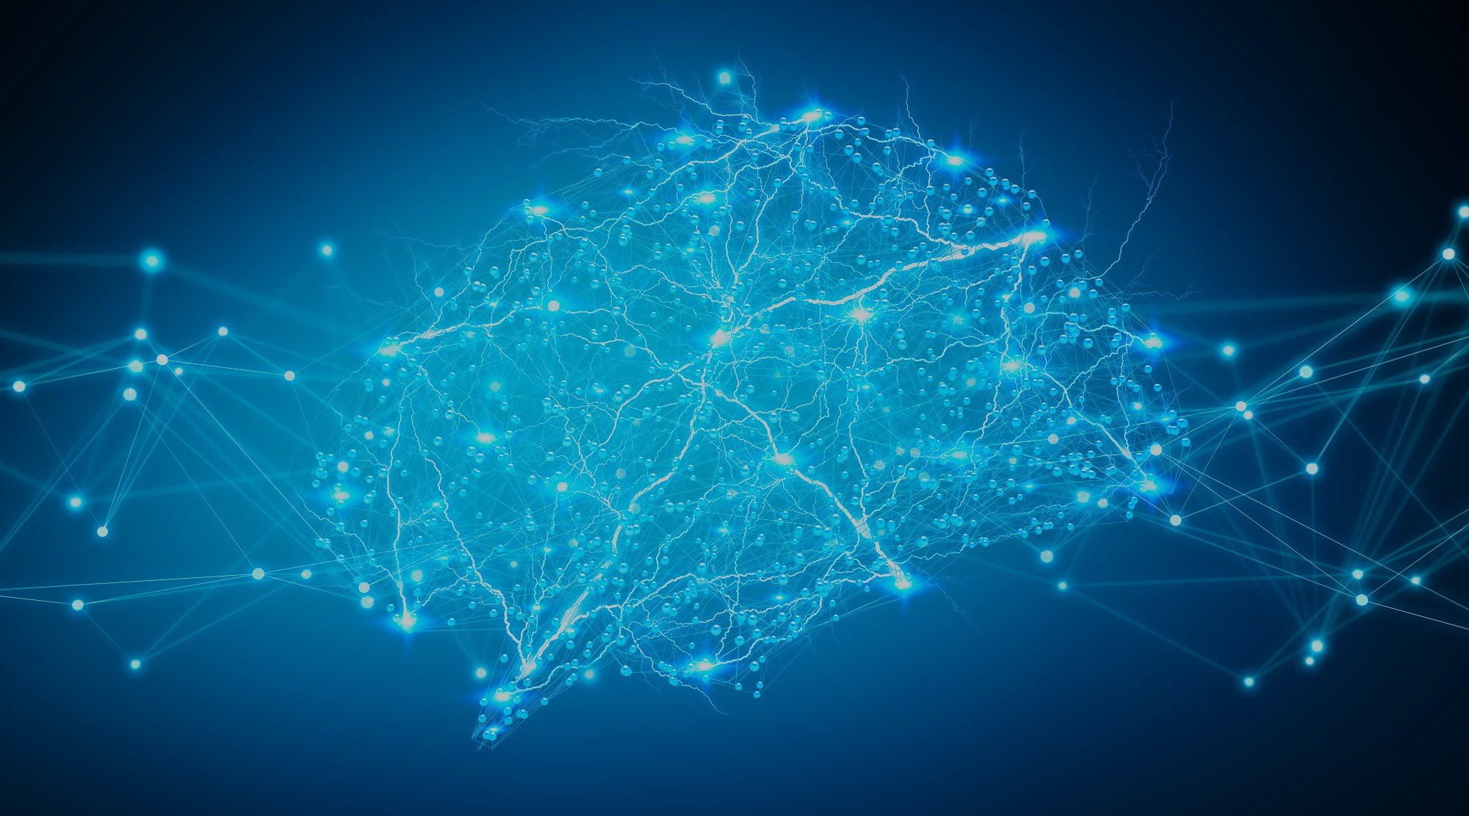
Generative Adversarial Transformers
Notes:
GIORGIA

Slide 10
Generative Adversarial Transformers [2]
Combination of StyleGAN2 and BERT attention mechanism to generate complex and more realistic examples
Why StyleGAN2?
Powerful generator for the overall style of the image with control of global features.
Why BERT attention mechanism?
Powerful with respect to small details of localised regions.
Notes:
GIORGIA

Slide 11
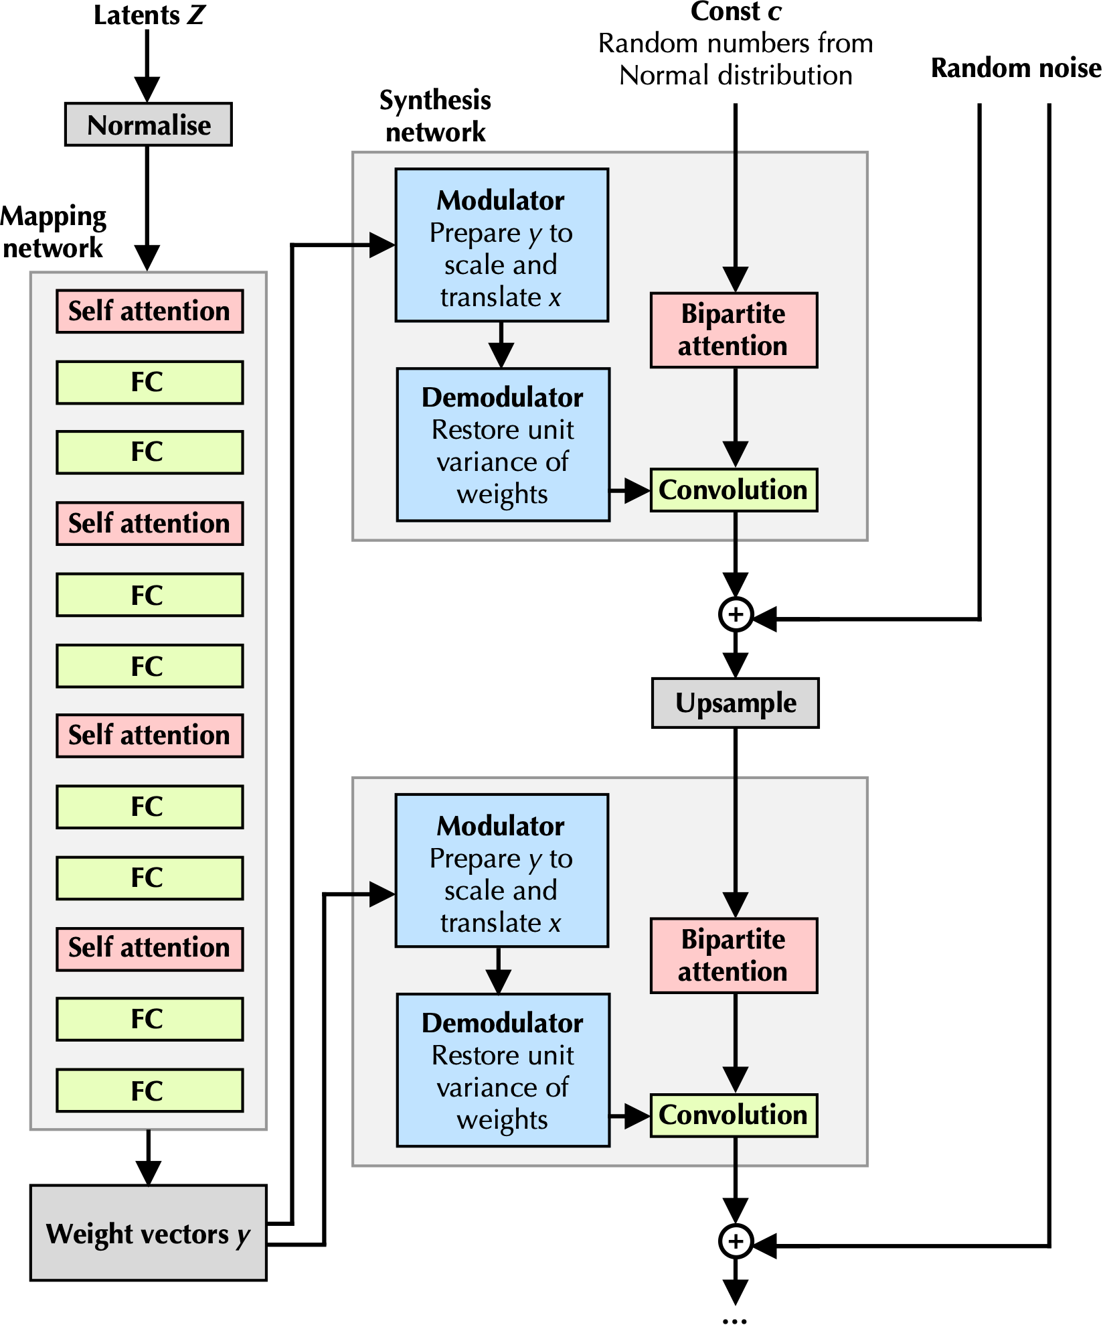
Generative Adversarial Transformers [2]
Standard transformer
Generator
GANformer uses self-attention only in the in the generator mapping network.
Alternates multi-head self-attention and feed-forward layers.
Notes:
GIORGIA

Slide 12
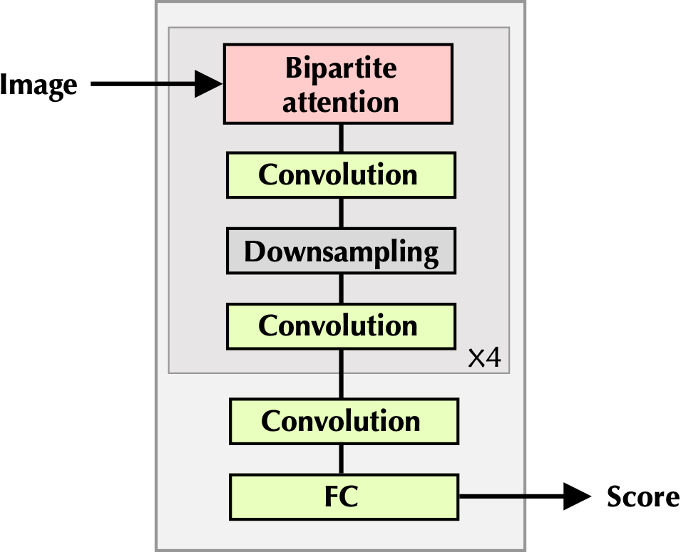
Generative Adversarial Transformers [2]
Generator
Bipartite transformer
Discriminator
Bipartite attention allows the network to decide which are the important image features using the latent variables.
Notes:
GIORGIA

Slide 13
Generative Adversarial Transformers [2]
Simplex attention
Duplex attention
permits communication in a single direction: latent vectors → image features
permits communication in both directions: first compute the attention assignments between image features and latent vectors and then refine the assignments of the image features by considering the centroids of the latents (k-means algorithm)
Notes:
Giorgia

Slide 14
Generative Adversarial Transformers [2]
Discriminator
Generator
Notes:
Giorgia

Slide 15
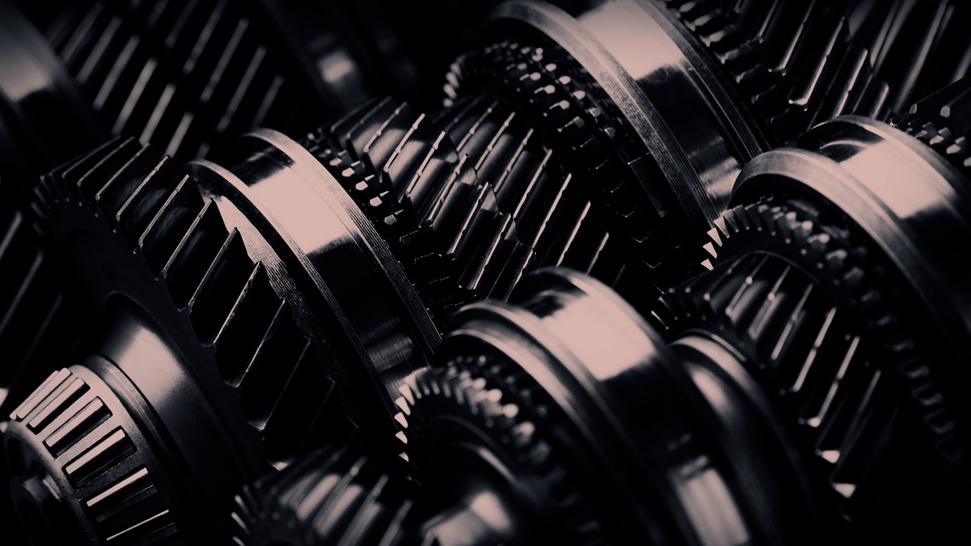
Implementation

Slide 16
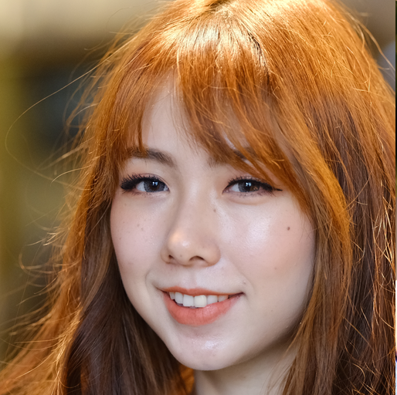
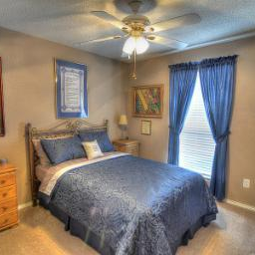
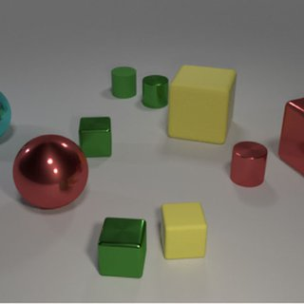
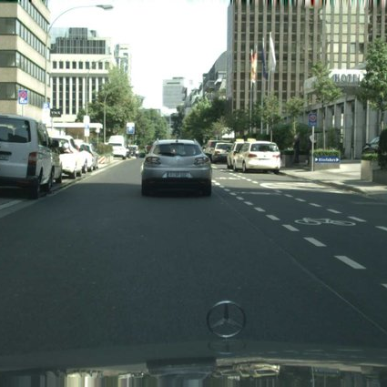
Datasets: Original paper
FFHQ
LSUN-Bedrooms
# Images: 70k
TFrecords size: 13 Gb
Resolution: 256x256
# Images: 3M
TFrecords size: 480 Gb
Resolution: 256x256
CLEVR
Cityscapes
# Images: 100k
TFrecords size: 15.5 Gb
Resolution: 256x256
# Images: 24k
TFrecords size: 8 Gb
Resolution: 256x256
Notes:
Stefano

Slide 17
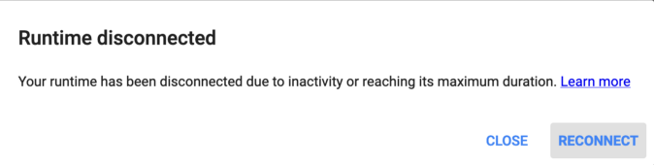

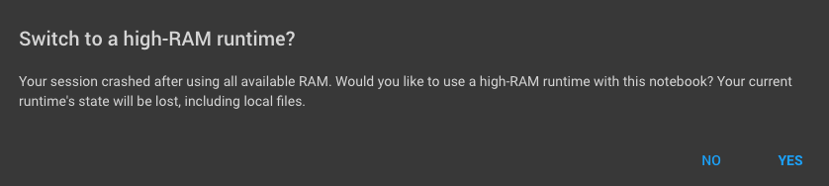
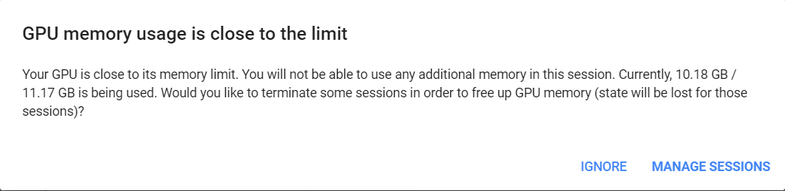
Datasets: First attempt
Notes:
Stefano

Slide 18


Datasets: Cartoonset 10k
Dataset size (Tfrecords): 1.8 Gb
Number of images: 10k
Image size: 64 x 64 pixels
A
Type | Attribute | Number of variants
Artwork | Eyes | 12
 | Glasses | 12
 | Face shape | 7
 | Hair | 111
 | Facial hair | 360
Colors | (A) Hair | 5
 | (B) Skin | 11
 | (C) Iris | 7
 | (D) Glasses | 10
Proportions | 4 attributes | 108
B
C
D
Notes:
Stefano

Slide 19
Hyper-parameters
Epsilon
Used to avoid division by zero
Beta1 & Beta2
Exponential decay rates for the moment estimates (mean and uncentered variance of gradients)
Component number
Features of the generated images
Latent size
Size of the latent vector (convolution weights)
Adam
Optimizer
Mapping
Network
Notes:
Stefano

Slide 20
Hyper-parameters discrepancies
Paper’s Hyperparameters
Model | StyleGAN2 | GANformers | GANformerd
Epsilon | 1E-08 | 0.001 | 0.001
Latent size | 512 | 32 | 32
Beta1 | 0.0 | 0.9 | 0.9
Beta2 | 0.99 | 0.999 | 0.999
Component Number | 1 | 16 | 16
Paper’s code Hyperparameters
Model | StyleGAN2 | GANformers | GANformerd
Epsilon | 1E-08 | 1E-08 | 1E-08
Latent size | 512 | 32 | 32
Beta1 | 0.0 | 0.0 | 0.0
Beta2 | 0.99 | 0.99 | 0.99
Component Number | 1 | 16 | 16
Notes:
Stefano

Slide 21

Hyper-parameters
?
Notes:
Stefano

Slide 22
Hyper-parameters
Our Choice
Our Hyperparameters
Model | StyleGAN2 | GANformers | GANformerd
Epsilon | 1E-08 | 1E-08 | 1E-08
Latent size | 512 | 32 | 32
Beta1 | 0.0 | 0.0 | 0.0
Beta2 | 0.99 | 0.99 | 0.99
Component Number | 1 | 16 | 16
Notes:
Stefano

Slide 23
Experimental setup & Computational requirements
Paper’s Implementation
Our implementation
Used four NVIDIA V100 GPUs per model.
Final results shown after 10,000K img samples.
Implemented in Python using TensorFlow.
Images set to 256x256 resolution.
Training for one model took 3-4 days.
Used one Tesla P100-PCIE-16GB GPU per model.
Final results shown after 300K img samples.
Implemented in Python using TensorFlow.
Images set to 64x64 resolution
Training for one model took 8-10 hours.
Notes:
Stefano

Slide 24
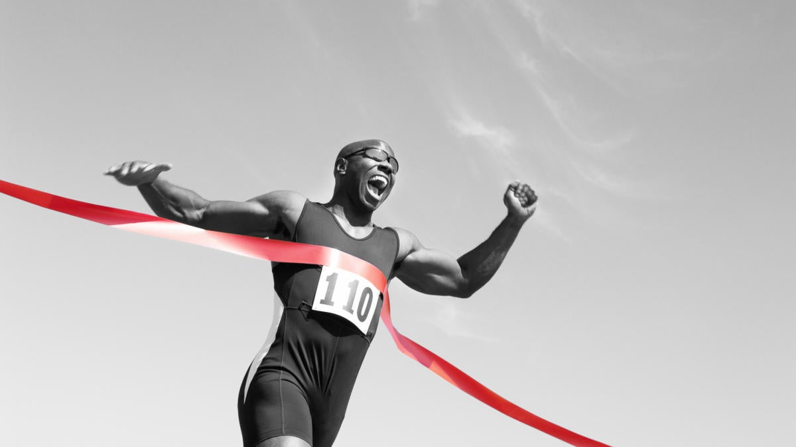
Results

Slide 25
Metrics
FID (Frechet Inception Distance)
Distance between feature distributions of real and fake images
IS (Inception Score)
Formalisation of the concept of “Realism” and “Diversity” only using generated images
Precision
Average similarity to the original images
Recall
Ability to generate any sample in the dataset
Training time
Notes:
Giorgia

Slide 26
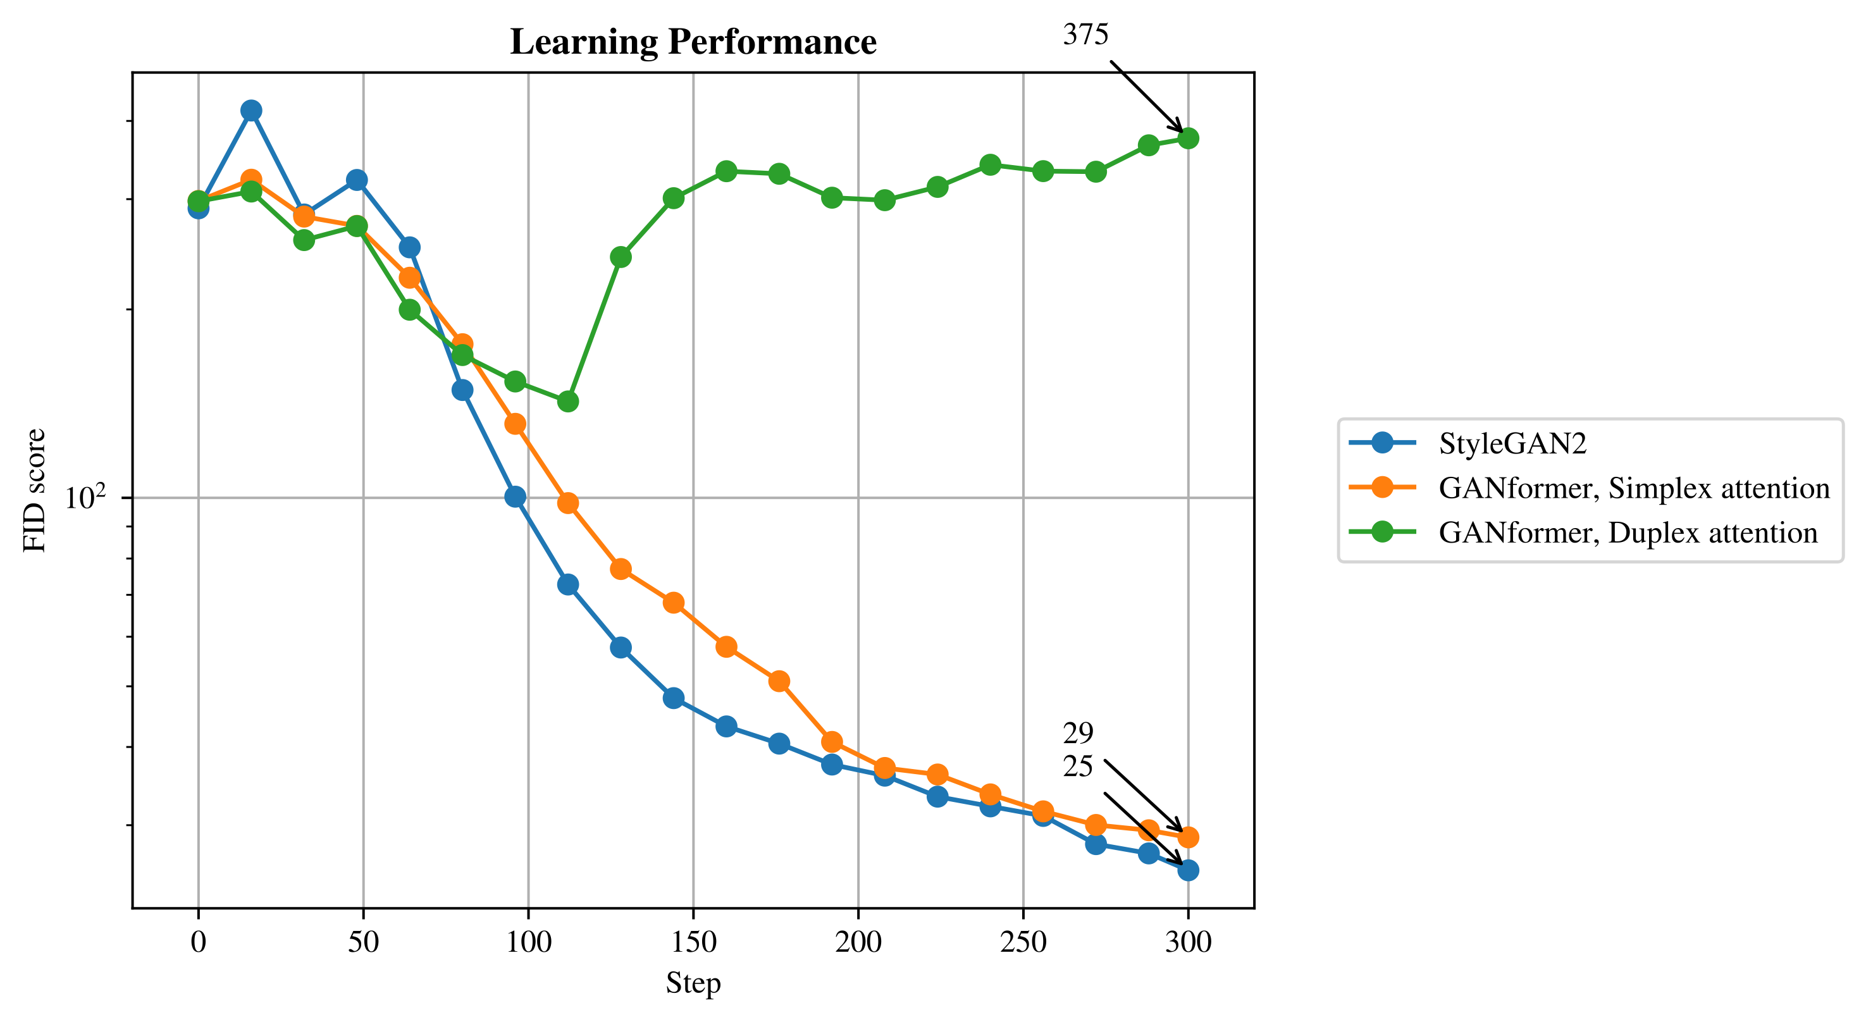
Analysis of FID scores
Notes:
Giorgia

Slide 27
Overall summary
Paper’s Results
Model | StyleGAN2 | GANformers | GANformerd
FID ↓ | 11.29 | 10.29 | 7.22
IS ↑ | 2.74 | 2.82 | 2.78
Precison ↑ | 52.02 | 56.76 | 55.45
Recall ↑ | 23.98 | 18.21 | 33.94
FID Improvement Over baseline | 0% | 8.86% | 36.11%
k-img/s | Not given | Not given | Not given
Our results
Model | StyleGAN2 | GANformers | GANformerd
FID ↓ | 24.77 | 28.11 | 374.18
IS ↑ | 2.50 | 2.58 | 1.40
Precison ↑ | 0.18 | 0.15 | 0
Recall ↑ | 2.11 | 0.76 | 0
FID Improvement Over baseline | 0% | -13.47% | -1410.47%
k-img/s | 91 | ~125 | ~125
Notes:
Giorgia

Slide 28


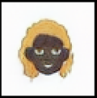
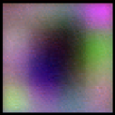
Generated images
GANformer Simplex Attention
GANformer Duplex Attention
Dataset
StyleGAN2
Notes:
Giorgia

Slide 29


Results
😢
Disappointing

Slide 30

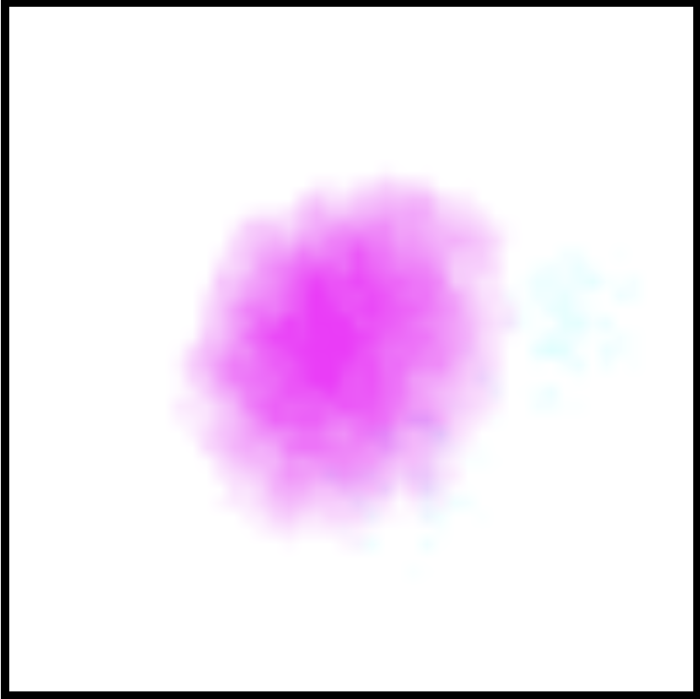
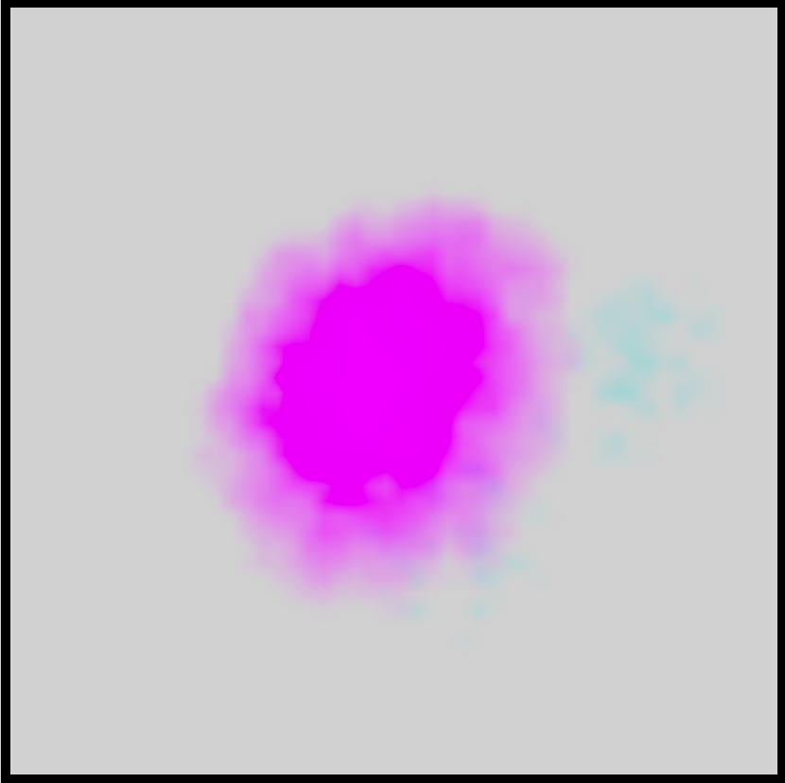
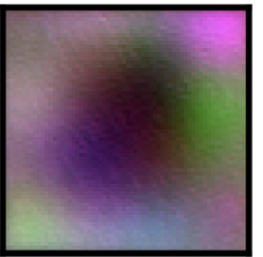

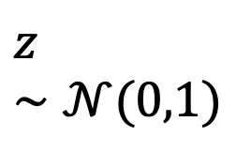

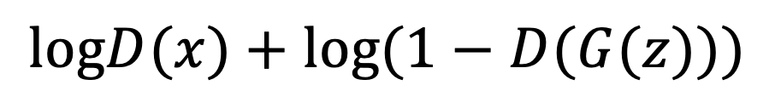
Why we think this is happening?
Real image $x$
K-means on real image expectation
$$logD(x)+log(1−D(G(z)))$$
Discriminator
K-means
Discriminator
Scoring
Bottom is real
$$z∼𝒩(0,1)$$
Generator
Generated Image
$$−log(1−D(G(z)))$$
Notes:
Felix

Slide 31
Why we think this is happening?
K-means takes regions of the image and will compute centroid/mean of the combined regions.
It uses the centroid/mean as a representative of those regions.
This will turn the real image into something that doesn’t look like the cartoon face.
The Generator will try to create those images to try and fool the Discriminator.
Notes:
Felix

Slide 32

Results
So how did they do it?
Notes:
Felix

Slide 33
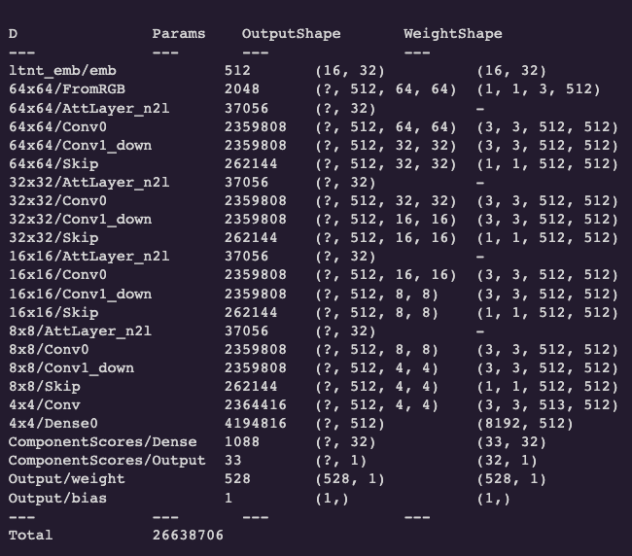
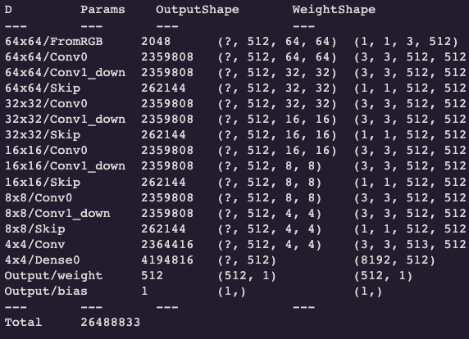
Pre-Trained model investigations
Expected Discriminator
Found Discriminator
Notes:
Felix

Slide 34
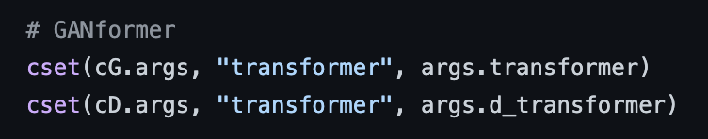

Code investigations
The authors never change the d-transformer argument!
Notes:
Felix

Slide 35
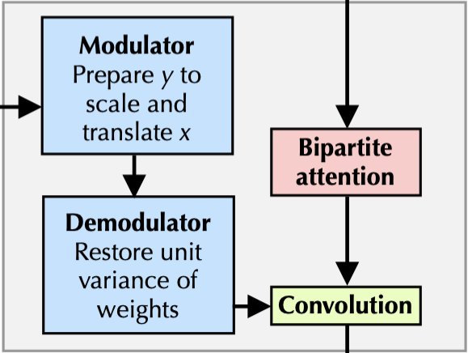
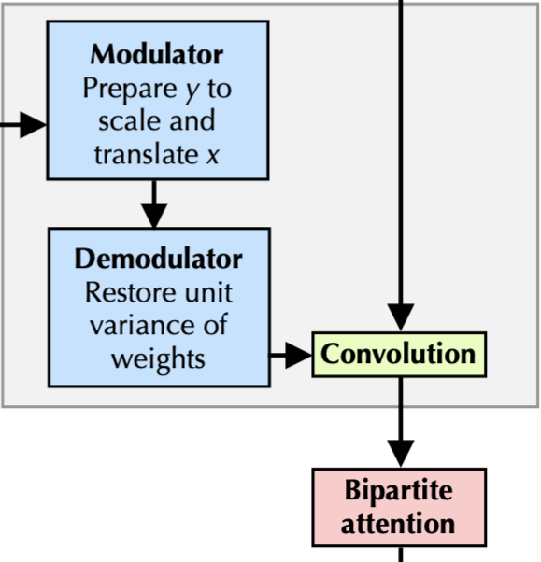
Code investigations
Bipartite attention position
Paper
Code
Notes:
Felix

Slide 36
Our solution:
StyleGAN2/GANformer hybrids
Notes:
Felix

Slide 37
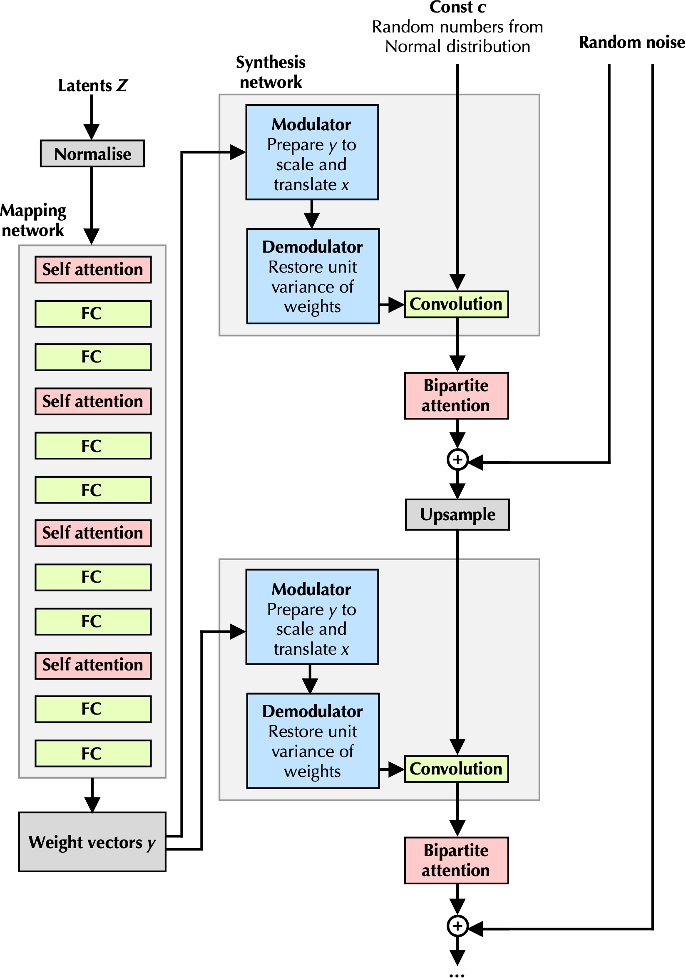
New implementation
Discriminator
Generator
Notes:
Felix

Slide 38
New overall summary
Previous results
Model | StyleGAN2 | GANformers | GANformerd
FID ↓ | 24.77 | 28.11 | 374.18
IS ↑ | 2.50 | 2.58 | 1.40
Precison ↑ | 0.18 | 0.15 | 0
Recall ↑ | 2.11 | 0.76 | 0
FID Improvement Over baseline | 0% | -13.47% | -1410.47%
k-img/s | 91 | ~125 | ~125
New results
Model | StyleGAN2 | GANformers Stylegan2 Discriminator | GANformerd Stylegan2 Discriminator
FID ↓ | 24.77 | 19.09 | 24.81
IS ↑ | 2.50 | 2.62 | 2.62
Precison ↑ | 0.18 | 0.35 | 0.35
Recall ↑ | 2.11 | 4.76 | 2.11
FID Improvement Over baseline | 0% | 22.93% | -0.14%
k-img/s | 91 | ~120 | ~120
Notes:
Felix

Slide 39
New overall summary
Paper’s Results
Model | StyleGAN2 | GANformers | GANformerd
FID ↓ | 11.29 | 10.29 | 7.22
IS ↑ | 2.74 | 2.82 | 2.78
Precison ↑ | 52.02 | 56.76 | 55.45
Recall ↑ | 23.98 | 18.21 | 33.94
FID Improvement Over baseline | 0% | 8.86% | 36.11%
k-img/s | Not given | Not given | Not given
New results
Model | StyleGAN2 | GANformers Stylegan2 Discriminator | GANformerd Stylegan2 Discriminator
FID ↓ | 24.77 | 19.09 | 24.81
IS ↑ | 2.50 | 2.62 | 2.62
Precison ↑ | 0.18 | 0.35 | 0.35
Recall ↑ | 2.11 | 4.76 | 2.11
FID Improvement Over baseline | 0% | 22.93% | -0.14%
k-img/s | 91 | ~120 | ~120
Notes:
Felix

Slide 40
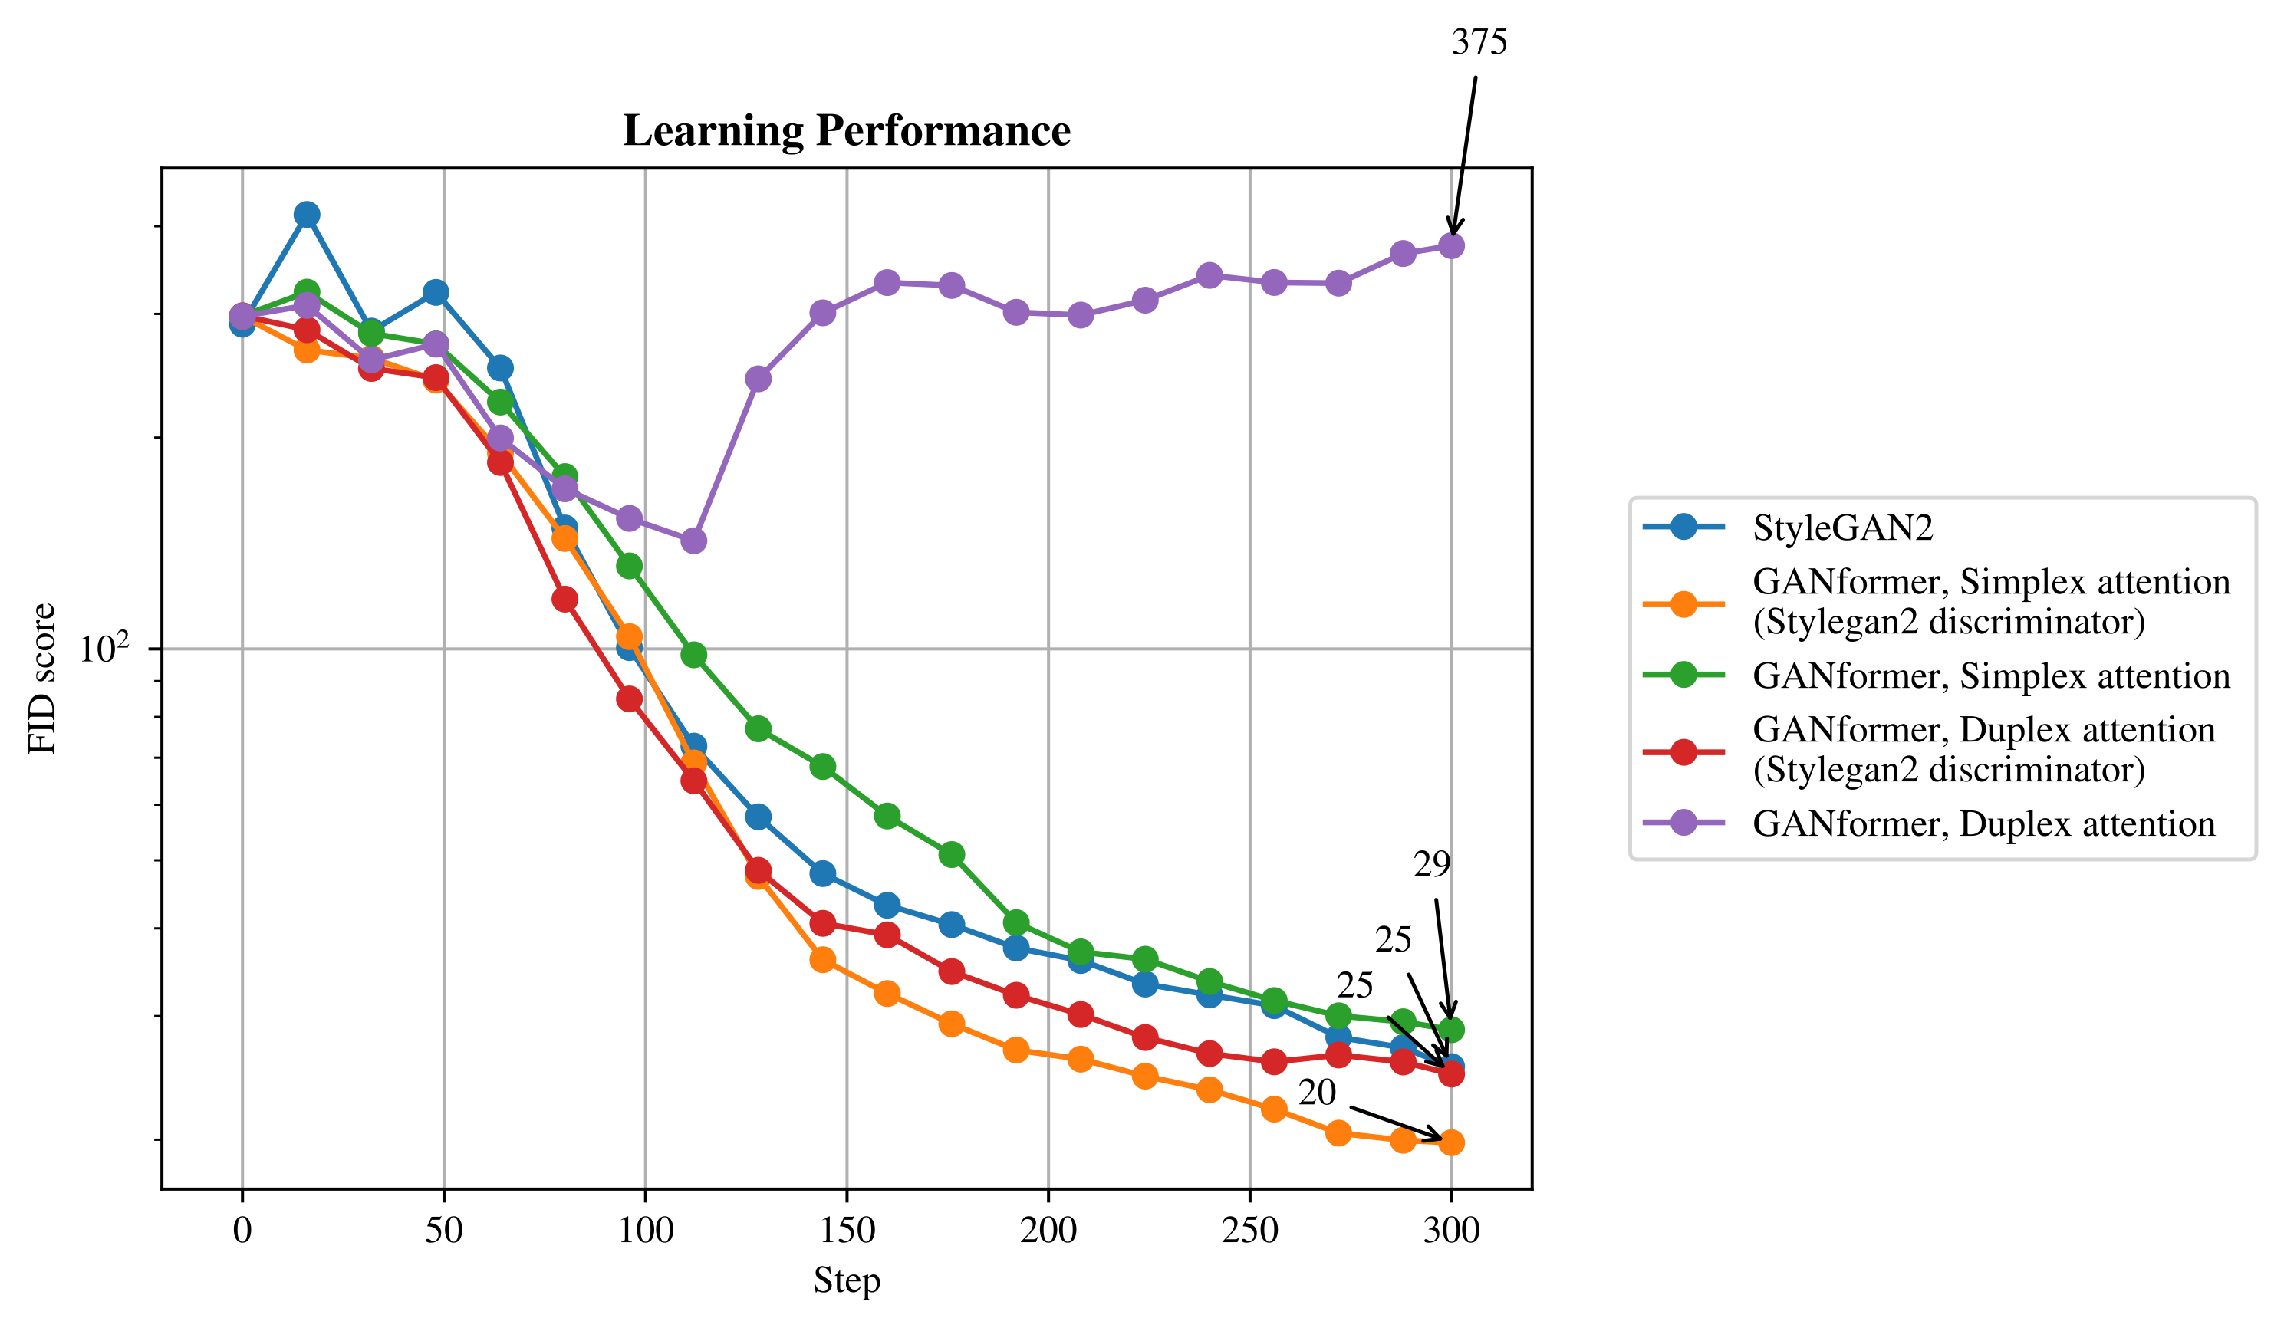
Analysis of FID scores
Notes:
Felix

Slide 41
Generated images
Notes:
FELIX

Slide 42
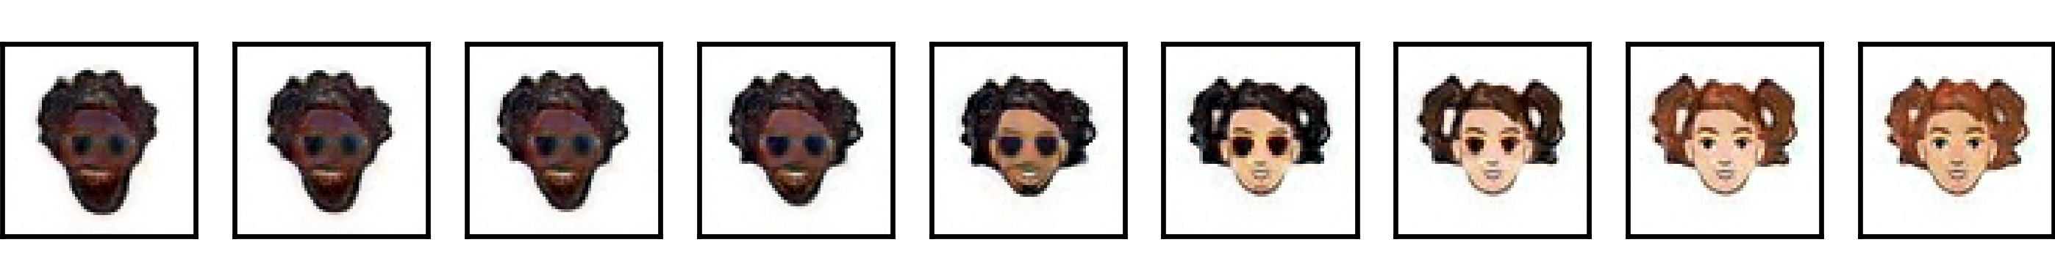
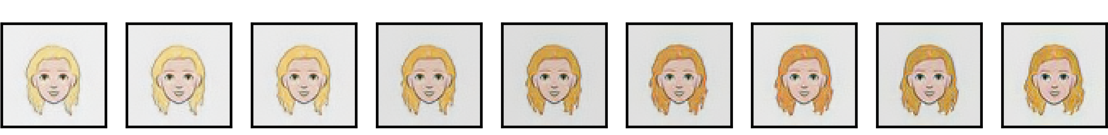
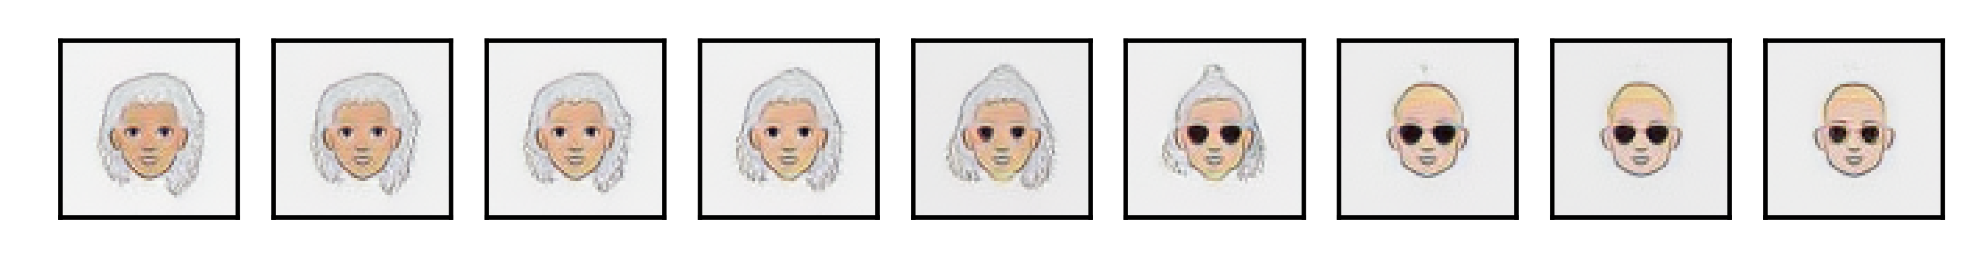
Generated images: interpolation
StyleGAN2
GANformer Simplex Attention with StyleGAN2 discriminator
GANformer Duplex Attention with StyleGAN2 discriminator
Notes:
Giorgia

Slide 43
Generated images (best model)
Notes:
Giorgia

Slide 44
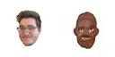





Style mixing
GANformer Simplex Attention with StyleGAN2 discriminator
Notes:
Giorgia

Slide 45
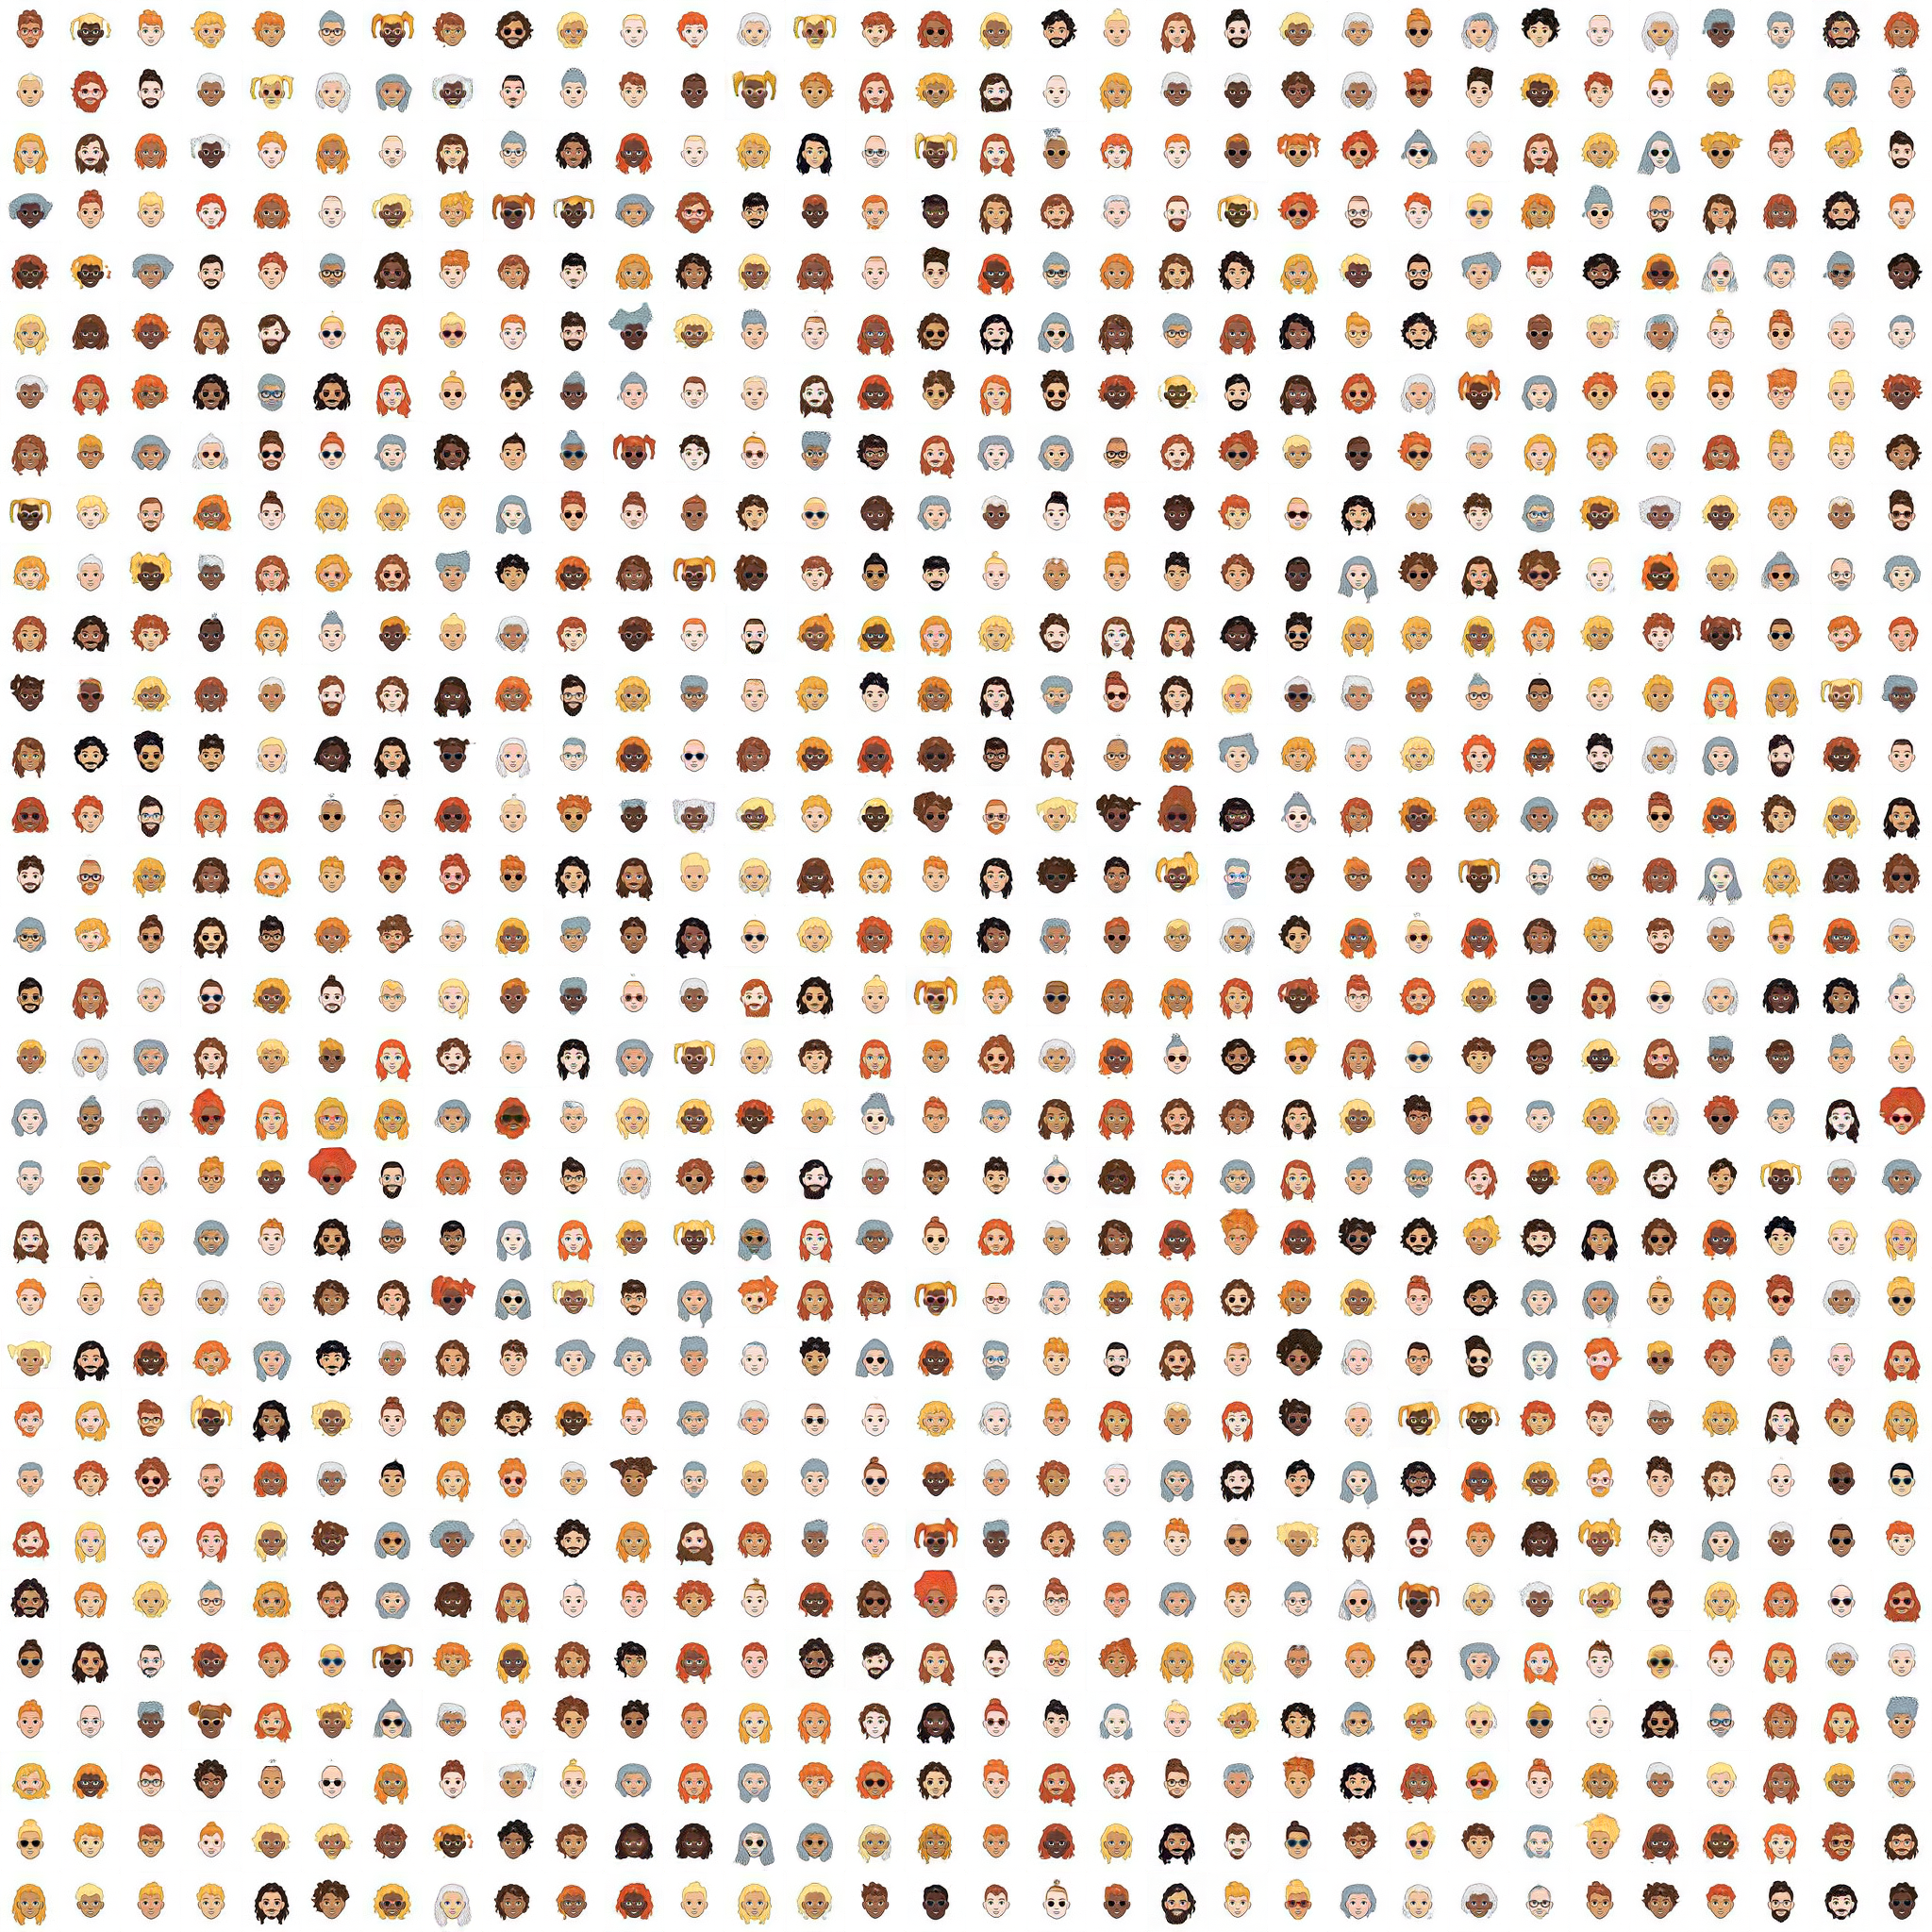
CONCLUSIONS

Slide 46
Conclusion
Reduced depth of our experiments:
Smaller and different dataset
Discard four out of the five baselines
Used models: StyleGAN2 and GANformer (Duplex and Simplex attention)
Google Colab Pro compatible version of the authors code to run (54 hours total)
Misleading paper claims and discrepancies w.r.t. code:
Discriminator attention
Hyperparameter discrepancies
Attention position on synthesis
substituting the hypothetically valid discriminator network with a vanilla StyleGAN discriminator.
New hybrid model performed significantly better than the baseline.
Qualitative results
Comment on results
Notes:
FELIX

Slide 47
The End

Slide 48
References
[1] Ian Goodfellow, Jean Pouget-Abadie, Mehdi Mirza, Bing Xu, David Warde-Farley, Sherjil Ozair, Aaron Courville, and Yoshua Bengio. Generative adversarial nets. In Proceedings of the 27th International Conference on Neural Information Processing Systems - Volume 2, NIPS’14, page 2672–2680. MIT Press, 2014. URL http: //arxiv.org/abs/1406.2661.
[2] Drew A. Hudson and C. Lawrence Zitnick. Generative Adversarial Transformers, 2021. URL http://arxiv. org/abs/2103.01209.
[3] Tero Karras, Samuli Laine, Miika Aittala, Janne Hellsten, Jaakko Lehtinen, and Timo Aila. Analyzing and improving the image quality of stylegan. In Proceedings of the IEEE/CVF Conference on Computer Vision and Pattern Recognition, pages 8110–8119, 2020. URL http://arxiv.org/abs/1912.04958.
[4] Tero Karras, Samuli Laine, and Timo Aila. A style-based generator architecture for generative adversarial networks. In Proceedings of the IEEE/CVF Conference on Computer Vision and Pattern Recognition, pages 4401–4410, 2019. URL http://arxiv.org/abs/1812.04948.
[5] Ashish Vaswani, Noam Shazeer, Niki Parmar, Jakob Uszkoreit, Llion Jones, Aidan N Gomez, Łukasz Kaiser, and Illia Polosukhin. Attention is all you need. In Advances in neural information processing systems, pages 5998–6008, 2017. URL http://arxiv.org/abs/1706.03762.
[6] Jacob Devlin, Ming-Wei Chang, Kenton Lee, and Kristina Toutanova. BERT: Pre-training of Deep Bidirectional Transformers for Language Understanding. In Proceedings of the 2019 Conference of the North American Chapter of the Association for Computational Linguistics: Human Language Technologies, Volume 1 (Long and Short Papers), pages 4171–4186. Association for Computational Linguistics, 2019. URL http://arxiv.org/abs/ 1810.04805.
[7] Justin Johnson, Bharath Hariharan, Laurens Van Der Maaten, Li Fei-Fei, C Lawrence Zitnick, and Ross Girshick. Clevr: A diagnostic dataset for compositional language and elementary visual reasoning. In Proceedings of the IEEE conference on computer vision and pattern recognition, pages 2901–2910, 2017. URL http: //arxiv.org/abs/1612.06890.

Slide 49
References
[8] Fisher Yu, Ari Seff, Yinda Zhang, Shuran Song, Thomas Funkhouser, and Jianxiong Xiao. Lsun: Construction of a large-scale image dataset using deep learning with humans in the loop, 2015. URL http://arxiv.org/abs/ 1506.03365.
[9] Marius Cordts, Mohamed Omran, Sebastian Ramos, Timo Rehfeld, Markus Enzweiler, Rodrigo Benenson, Uwe Franke, Stefan Roth, and Bernt Schiele. The cityscapes dataset for semantic urban scene understanding. In Proceedings of the IEEE conference on computer vision and pattern recognition, pages 3213–3223, 2016. URL http://arxiv.org/abs/1604.01685v2.
[10] Cole Forrester, Mosseri Inbar, Krishnan Dilip, Sarna Aaron, Maschinot Aaron, Freeman Bill, and Fuman Shiraz. Cartoon set. https://google.github.io/cartoonset/, 2018.
[11] Martín Abadi, Ashish Agarwal, Paul Barham, Eugene Brevdo, Zhifeng Chen, Craig Citro, Greg S. Corrado, Andy Davis, Jeffrey Dean, Matthieu Devin, Sanjay Ghemawat, Ian Goodfellow, Andrew Harp, Geoffrey Irving, Michael Isard, Yangqing Jia, Rafal Jozefowicz, Lukasz Kaiser, Manjunath Kudlur, Josh Levenberg, Dandelion Mané, Rajat Monga, Sherry Moore, Derek Murray, Chris Olah, Mike Schuster, Jonathon Shlens, Benoit Steiner, Ilya Sutskever, Kunal Talwar, Paul Tucker, Vincent Vanhoucke, Vijay Vasudevan, Fernanda Viégas, Oriol Vinyals, Pete Warden, Martin Wattenberg, Martin Wicke, Yuan Yu, and Xiaoqiang Zheng. TensorFlow: Large-Scale Machine Learning on Heterogeneous Systems, 2015. URL https://www.tensorflow.org/. Software available from tensorflow.org.
[12] Ishaan Gulrajani, Faruk Ahmed, Martin Arjovsky, Vincent Dumoulin, and Aaron Courville. Improved Training of Wasserstein GANs. arXiv:1704.00028 [cs, stat], December 2017. URL http://arxiv.org/abs/1704.00028. arXiv: 1704.00028 version: 3.
[13] Martin Arjovsky, Soumith Chintala, and Léon Bottou. Wasserstein GAN. arXiv:1701.07875 [cs, stat], 2017. URL http://arxiv.org/abs/1701.07875.
[14] Xun Huang and Serge Belongie. Arbitrary style transfer in real-time with adaptive instance normalization, 2017.

